Slide 1

Containerisation with docker

Slide 2
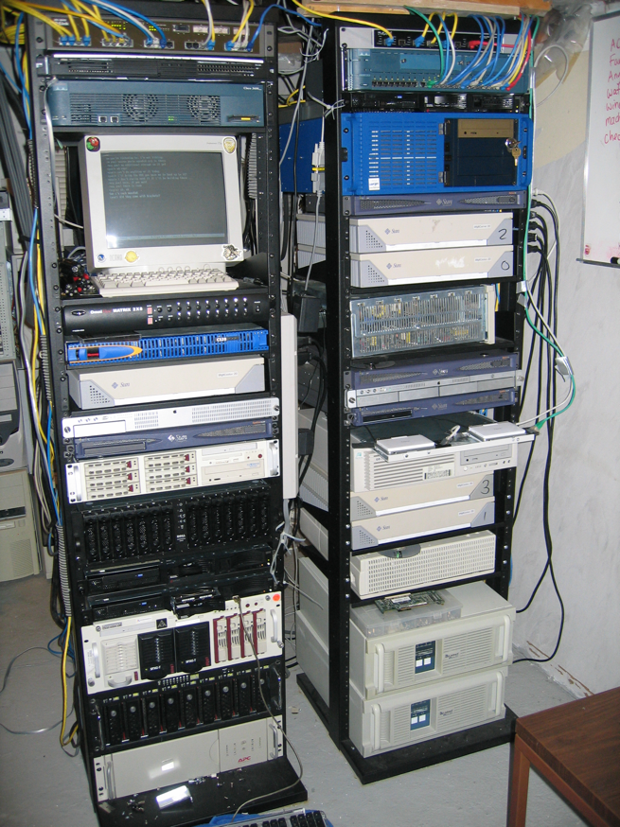
Before the dawn of time…..
Each application was housed in servers like these!
Each box housed “a” database, “a” service (eg web, mail, etc).
When you wanted to start a new database, you bought one of these (or cleaned one up)

Slide 3
Age of Virtualisation
The process of creating logical computing resources from available physical resources
Layer of abstraction between workloads and the underlying physical hardware
Many virtual servers living and breathing on one physical server!
And we could virtualise at Server, Storage, Network, Desktop, Application level!

Slide 4
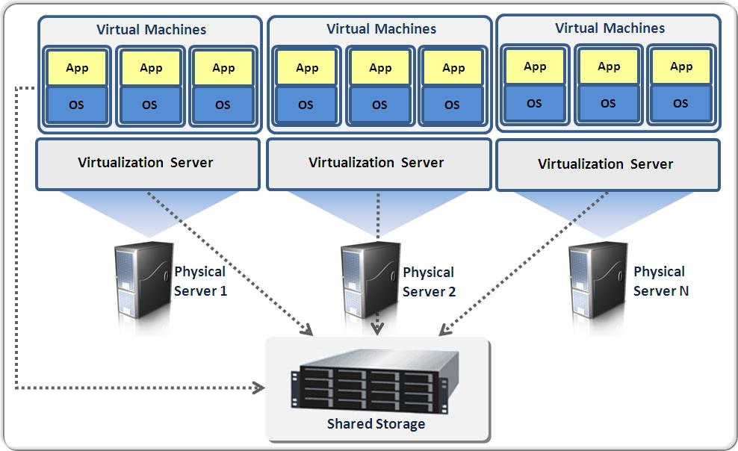

Slide 5
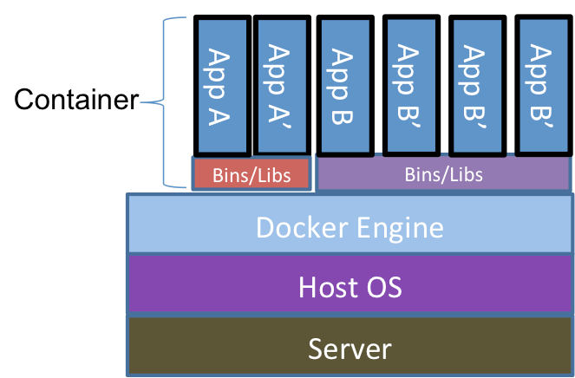
Age of Containerisation

Slide 6
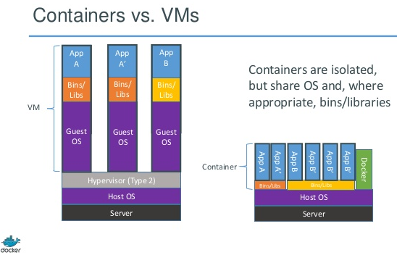
http://www.theplatform.net/2015/03/23/hpc-schedulers-snap-to-docker/

Slide 7
LXC Containers
Effectively advanced chroot jails
  A set of processes
  Isolated from the rest of the machine
  using namespaces to have some limited view of the system
  And cgroups to have some limited control of resources
Like VMs, but MUCH slinkier!!
  Cut-down versions of the OS
  Disposable
  VERY lightweight!!!

Slide 8
So, what’s Docker, then?
Effectively? An easier and more streamlined LXC creation process.
  Commoditised LXC!
  Because containerisation is the new cool way to
  build, ship, deploy and run your apps!
Docker takes LXC as a base and runs the container OS + an init system.
Resulting container:
  can only run a single app at a time
  removes storage persistence
  builds the file system with layers of aufs

Slide 9
Why are they all the rage nowadays?
No need to run OS on top of OS anymore
Reduced resources
Micro-services
Development, testing, production benefits
  Able to test complex setups
  Able to run multiple complex tests
  Able to package, deploy and run a complete application quikly
    Avoid dependency conflict issues

Slide 10
The Life of a Container
– Conception
• BUILD an Image from a Dockerfile
– Birth
• RUN (create+start) a container
– Reproduction
• COMMIT (persist) a container to a new image
• RUN a new container from an image
– Sleep
• KILL a running container
– Wake
• START a stopped container
– Death
• RM (delete) a stopped container
• Extinction
– RMI a container image (delete image)

Slide 11
Dockerfile ……
Like a Makefile (shell script with keywords)
Extends from a Base Image
Results in a new Docker Image
Imperative, not Declarative
A Docker file lists the steps needed to build an images
Docker build is used to run a Docker file
Can define default command for docker run, ports to expose, etc

Slide 12
Let’s run sample with katacoda
https://www.katacoda.com/courses/dotnet-in-docker/deploying-aspnet-core-as-docker-container
Or do it in
Azure vm

